Slide 1
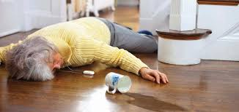
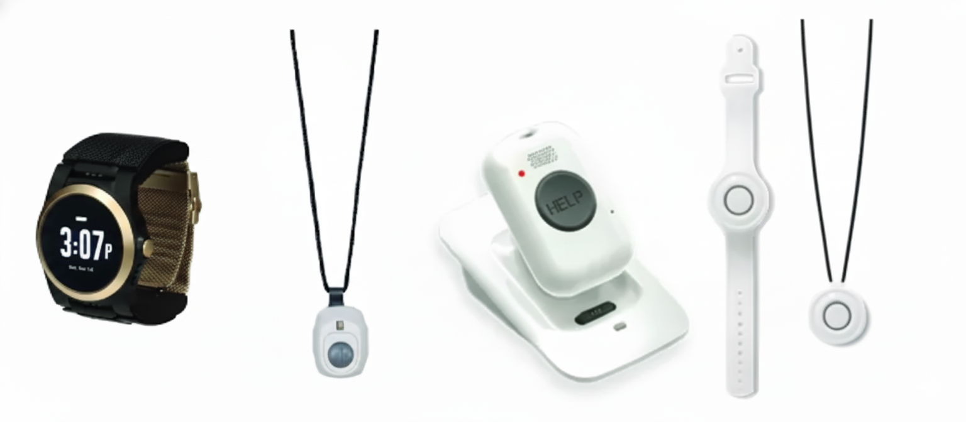
Needs Statement:
A way to reduce time-to-assist for unwitnessed falls for elderly individuals living in long term care homes that reduces the severity of adverse events and maximizes post-incident recovery outcomes
Background Information:
Falls are the leading cause of injury hospitalizations and injury deaths among adults ≥65 [1]
Lighting is often below recommendations in resident rooms and especially bathrooms; lower lighting correlates with higher fall rates [2] [3]
lower lighting correlates with higher fall rates
LTC residents experience high annual fall incidence in nursing home[2]
Stakeholder Insights:
Residents: fear, embarrassment, privacy concern, faster discovery [4] [5]
PSW/nurses: unwitnessed events, alarm fatigue, SOS triaging ineffectiveness [5]
Competitor Analysis Trends:
False Positives [6]
High Cost [6]
Poor Ergonomics [7]
Privacy Concern
Ineffective in certain environments [7]

Slide 2
References
[1]https://www.canada.ca/en/public-health/services/reports-publications/health-promotion-chronic-disease-prevention-canada-research-policy-practice/vol-44-no-11-12-2024/temporal-trends-characteristics-fall-related-deaths-hospitalizations-emergency-department-visits-older-adults-canada.html
[2] J. Kubitza, I. T. Schneider, and B. Reuschenbach, “Concept of the term long lie: A scoping review,” European review of aging and physical activity : official journal of the European Group for Research into Elderly and Physical Activity, https://pmc.ncbi.nlm.nih.gov/articles/PMC10463813/ (accessed Nov. 3, 2025).
[3] Emad Y;Neef SP;Taylor L;Kerse N;Cavadino A;Moyes SA;Comber K;Wu XS;Molloy J;Bacon CJ;, “Shedding light on falls: The effect of lighting levels on fall risk in long-term residential care facilities,” Journal of applied gerontology : the official journal of the Southern Gerontological Society, https://pubmed.ncbi.nlm.nih.gov/39626350/ (accessed Nov. 3, 2025).
[4] Guidelines for the use of Video Surveillance October 2015, https://www.ipc.on.ca/sites/default/files/legacy/Resources/2015_Guidelines_Surveillance.pdf (accessed Nov. 3, 2025).
[5] M. Takase, “Falls as the result of interplay between nurses, patient and the environment: Using text-mining to uncover how and why falls happen,” International journal of nursing sciences, https://pmc.ncbi.nlm.nih.gov/articles/PMC9969063/ (accessed Nov. 3, 2025).
[6 ]Conversation with stakeholder (elderly fall risk individuals)
[7] Conversation with stakeholder (personal support workers and nurses at Long Term Care homes)

